Slide 1
Cyclistic Bike-Share User Analysis
A Data-Driven Strategy to Convert Casual Riders into Annual Members
Presented to: Lily Moreno & The Cyclistic Executive Team | August 5, 2025
Presented by: Rushang Tailor

Slide 2
The Business Task
Objective:
Problem:
To increase profitability by designing a marketing strategy that converts casual riders into annual members
How do annual members and casual riders use Cyclistic bikes differently?

Slide 3
Data & Methodology
Data Source: 12 months of Cyclistic's historical trip data, combined into a single dataset
Tools: Microsoft Excel
Process:
Combine 12 Seperate Excel Sheet
Cleaned the data by removing invalid trips and handling missing values
Created new fields for analysis : ‘ride_length’, ‘day_of_week’, ‘hours_of_day
Aggregated the data to perform descriptive analysis.

Slide 4
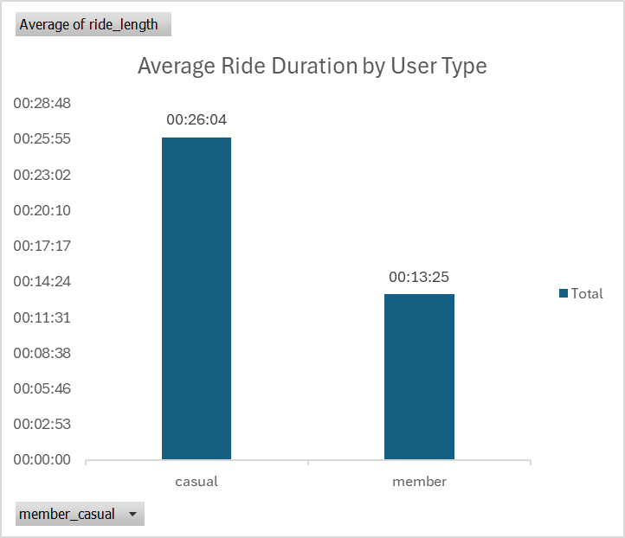
Ride Duration
Casual riders take significantly longer trips than annual members, suggesting different trip purposes

Slide 5
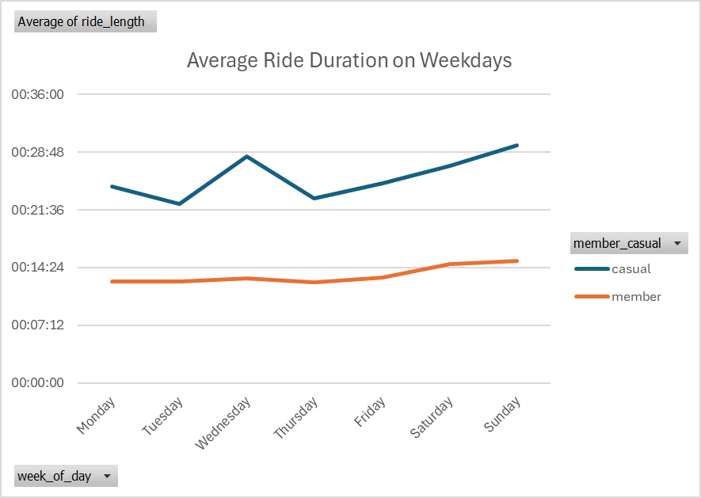
Weekly User Patterns
Members are consistently throughout the week, while casual usage spikes dramatically on weekends.

Slide 6
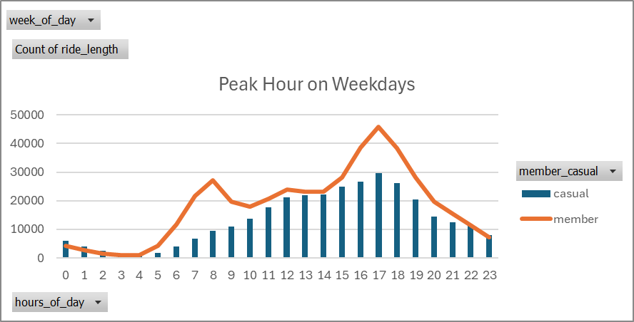
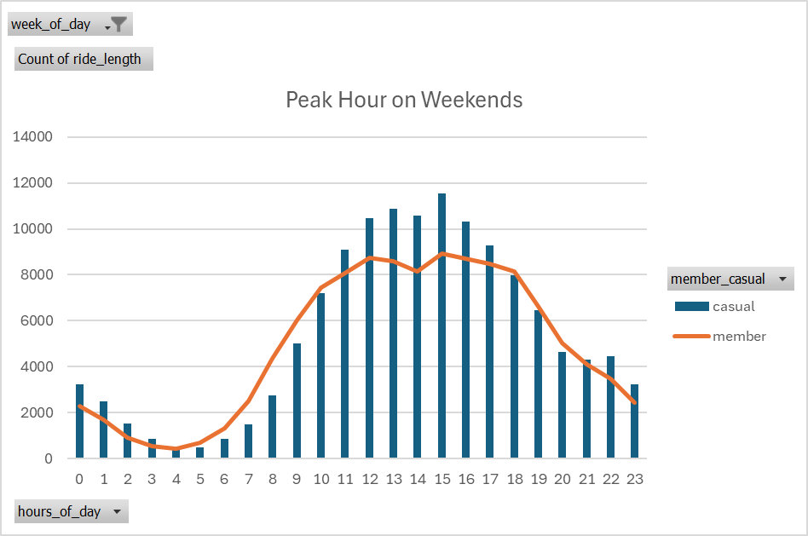
Peak Usage Hours
The time of the day riders are further confirms their different use cases.

Slide 7
Summary of Findings
The data reveals two distinct personas: The “Weekday warrior” (Member) and the “Weekend Explorer” (Casual).
Attribute | Annual Members | Casual Riders
Primary Use Case | Commuting & Functional Trips | Leisure & Recreation
Average Ride Time | Short(13 mins) | Long(26 mins)
Peak Days | Weekdays | Weekends
Peak Hours | 7-9 & 15-19 (Weekdays) | 11 - 17 (weekends)

Slide 8
Recommendations
How to Convert the “Weekend Explorer”
“Ride to Own” Campaign
Use in -app messaging after a long ride to show users how much they would have saved with a membership, creating immediate value perception.
03
Launch a “Weekend Pass”
Create a lower cost membership tier offering unlimited rides on Saturdays and Sundays to directly target the primary use case of casual Riders.
01
02
Target Weekday Casuals
Run targeted digital ads for the smaller group of weekday casual riders, focusing on the cost savings and convenience of a full membership for commuting.

Slide 9
Thank You
Questions?

